Slide 1


Slide 2
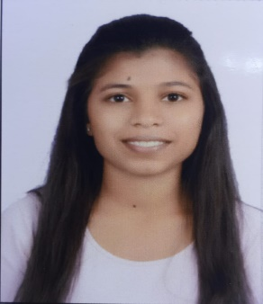
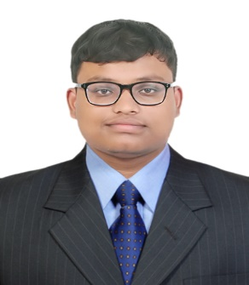
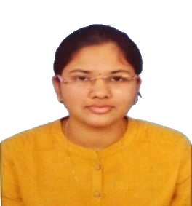
Project Highlights
Project Name : Quiz Simulation
Team Size : 3
BU Mentor Name : Neha Bandi Mentor PS#
Tejasvi Mhase
99002669
2009BLRICP01
BE(Electronics) Teamwork, Problem Solving
Subhrosil Maiti
99002658
2009BLRICP01
BTech.(EEE)
Python, JAVA, HTML5,CSS
Anusha Avvaru
99002667
2009BLRICP01
BE(EEE)
Communication

Slide 3
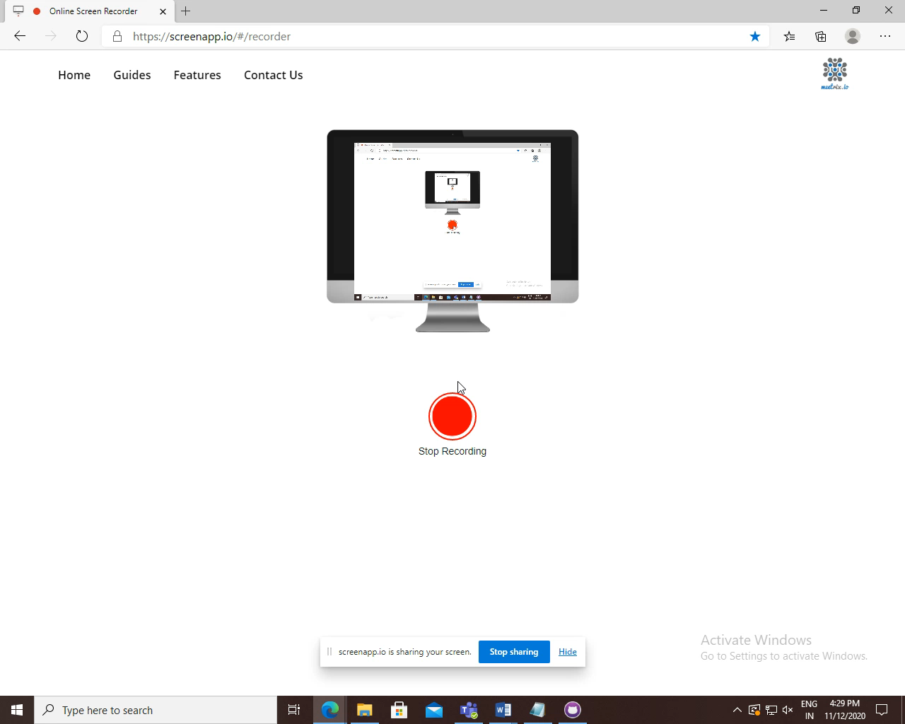
Project Video Snippet

Slide 4
Future development that can be implemented further
The questions can be jumbled up
There can be different sets of questions, which can be maintained in a separate SQL database, making it easier to change/modify the questions.
The project can be used as an exam site

Slide 5


Thank You !

